Slide 1
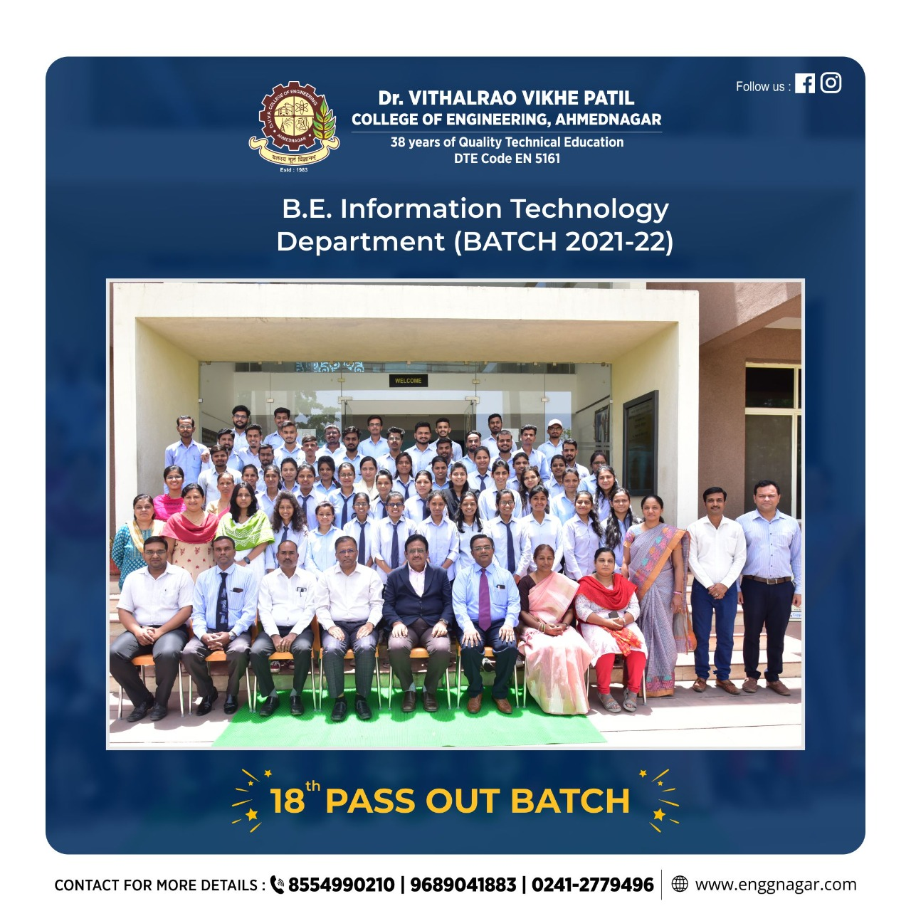
Empowering E-Healthcare

Slide 2
Empowering E-Healthcare

Slide 3




A ROBUST SECURE DATA SHARING AND AUTHORIZATION FRAMEWORK
PRESENTED BY:
HARSH RAJA
VISHAL RATHOD PARAG PALASKAR TAMBOLI DANISH
SAYED HAMZA
PROJECTGUIDE : DR.D.A.VIDHATE

Slide 4
A ROBUST SECURE DATA SHARING AND AUTHORIZATION FRAMEWORK
PRESENTED BY:
HARSH RAJA
VISHAL RATHOD PARAG PALASKAR TAMBOLI DANISH
SAYED HAMZA
PROJECT GUIDED BY
DR.D.A.VIDHATE

Slide 5
CONTENTS
The precise problem statement/title based on literature survey and feasibility study.
Motivation, objectives, and scope of the project.
List of required hardware, software, or other equipment for executing the project, test Environment/tools, cost and software measurement/human efforts in hours.
System overview
Architecture and initial phase and lock Daigram

Slide 6
CONTENTS
The precise problem statement/title based on literature survey and feasibility study.
Motivation, objectives, and scope of the project.
List of required hardware, software, or other equipment for executing the project, test Environment/tools, cost and software measurement/human efforts in hours.
System overview
Architecture and initial phase and Block diagram.
DFD
System Methodology
Working Moules

Slide 7
LITERATURE REVIEW
SR NO | Paper Title | Authors | Research Outcome
1 | Towards a secure incremental proxy re‐encryption for e‐healthcare data sharing in cloud computing | Tarunpreet Bhatia Thapar University A.K. Verma Gaurav Sharma Université Libre de Bruxelles | propose a pairing‐free incremental proxy re‐encryption scheme, without certificates, which would run proportionate to the number of modifications in time,
2 | ‘Searchable encryption revisited: Consistency properties, relation to anonymous IBE, and extensions | M. Abdalla, M. Bellare, D. Catalano, E. Kiltz, T. Kohno, T. Lange, J. Malone-Lee, G. Neven, P. Paillier, and H. Shi | Advance Encryption System

Slide 8
LITERATURE REVIEW
SR NO | Paper Title | Authors | Research Outcome
1 | Towards a secure incremental proxy re‐encryption for e‐healthcare data sharing in cloud computing | Tarunpreet Bhatia Thapar University A.K. Verma Gaurav Sharma Université Libre de Bruxelles | propose a pairing‐free incremental proxy re‐encryption scheme, without certificates, which would run proportionate to the number of modifications in time,
2 | ‘Searchable encryption revisited: Consistency properties, relation to anonymous IBE, and extensions | M. Abdalla, M. Bellare, D. Catalano, E. Kiltz, T. Kohno, T. Lange, J. Malone-Lee, G. Neven, P. Paillier, and H. Shi | Advance Encryption System

Slide 9
LITERATURE REVIEW
SR NO | Paper Title | Authors | Research Outcome
3 | Searchable encryption revisited: Consistency properties, relation to anonymous IBE, and extensions. | ] M. Abdalla, M. Bellare, D. Catalano, E. Kiltz, T. Kohno, T. Lange, J. Malone-Lee, G. Neven, P. Paillier, and H. Shi | Identifies and filled some gaps with regards to consistency for public key
4 | Improved proxy re-encryption schemes with applications to secure distributed storage | G. Ateniese, K. Fu, M. Green, and S. Hohenberger | Demonstrate the usefulness of proxy re-encryption as a method of adding access control to a secure file system.
5 | Public key encryption with keyword search revisited | J. Baek, R. Safavi-Naini, and W. Susilo | The public key encryption with keyword search (PEKS) scheme, proposed by Boneh, Di Crescenzo, Ostrovsky and Persiano, enables one to search for encrypted keywords without compromising the security of the original data.

Slide 10

MOTIVATION
Uni-Directional: Uni-directional proxy re-encryption is more superior than multi-directional proxy re-encryption.
Proxy-Invisible: To ensure the integrity and confidentiality of data, e-healthcare systems must implement measures to provide proxy-invisibility.
Condition-Hiding: In the conditional proxy re-encryption scheme, the condition often contains some private information.
Collusion-Resistance: It ensures that a re-encrypted ciphertext is indistinguishable from an original ciphertext, preventing malicious users from distinguishing between the two.

Slide 11
MOTIVATION
Uni-Directional: Uni-directional proxy re-encryption is more superior than multi-directional proxy re-encryption.
Proxy-Invisible: To ensure the integrity and confidentiality of data, e-healthcare systems must implement measures to provide proxy-invisibility.
Condition-Hiding: In the conditional proxy re-encryption scheme, the condition often contains some private information.
Collusion-Resistance: It ensures that a re-encrypted ciphertext is indistinguishable from an original ciphertext, preventing malicious users from distinguishing between the two.

Slide 12

OBJECTIVES
Improve Patient Safety
Support Effective and Efficient Healthcare Delivery
Facilitate Management of Chronic Conditions
Easy Management and Sharing of Information
Improve Medical Personnel Performance
Enhance Patient Care and Physician-Patient Interactions
Promote Health

Slide 13
OBJECTIVES
Improve Patient Safety
Support Effective and Efficient Healthcare Delivery
Facilitate Management of Chronic Conditions
Easy Management and Sharing of Information
Improve Medical Personnel Performance
Enhance Patient Care and Physician-Patient Interactions
Promote E-Healthcare

Slide 14

SCOPE
Data privacy: patients data collected by the sensor devices are encrypted before they are uploaded to the cloud storage server.
Conditional authorization: Our scheme enables the delegation of the task to another doctor through a cloud server, without the need to decrypt the PHRs thus minimizing information exposure to the cloud server.
Condition-hiding: Our scheme not only guarantees patient's PHRs privacy through encrypted data but also preserves the privacy of the condition embedded in the re-encryption key.
Proxy invisibility: In our scheme, the authorized doctor (Bob) or a malicious user cannot distinguish which ciphertext is sent to delegate and which ciphertext is re-encrypted by the cloud delegated by Alice.
Collusion resistance: In our scheme, even a dishonest proxy colludes with Bob, Alice’s private key can still be secure.

Slide 15
SCOPE
Data privacy: patients data collected by the sensor devices are encrypted before they are uploaded to the cloud storage server.
Conditional authorization: Our scheme enables the delegation of the task to another doctor through a cloud server, without the need to decrypt the PHRs thus minimizing information exposure to the cloud server.
Condition-hiding: Our scheme not only guarantees patient's PHRs privacy through encrypted data but also preserves the privacy of the condition embedded in the re-encryption key.
Proxy invisibility: In our scheme, the authorized doctor (Bob) or a malicious user cannot distinguish which ciphertext is sent to delegate and which ciphertext is re-encrypted by the cloud delegated by Alice.
Collusion resistance: In our scheme, even a dishonest proxy colludes with Bob, Alice’s private key can still be secure.

Slide 16
ENTITIES
PATIENTS
DOCTOR-IN-CHARGE
ONLY AUTHORIZED DOCTORS OR RESEARCH INSTITUTIONS HAVE ACCESS TO THE PHR

Slide 17
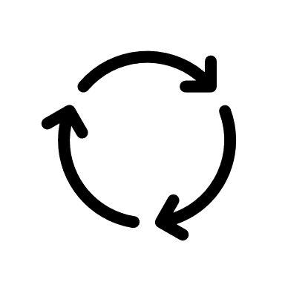
ENTITIES
PATIENTS
DOCTOR-IN-CHARGE
ONLY AUTHORIZED DOCTORS OR RESEARCH INSTITUTIONS HAVE ACCESS TO THE PHR

Slide 18



TOOLS USED
Software Requirement
Operating System - Windows 7/8/10
Application Server - Drive HQ
Front End - HTML, JSP, CSS, Bootstrap
Scripts - JavaScript.
Database - My SQL
Tool -NetBeans 8.2
IDE - VS COES
Hardware Requirement
Processor - Intel i3/i5/i7
RAM - 3GB (min)
Hard Disk - 100 GB

Slide 19
TOOLS USED
Software Requirement
Operating System - Windows 7/8/10/11
Application Server - Drive HQ
Front End - HTML, JSP, CSS, Bootstrap
Database - My SQL
Tool -NetBeans 8.2
Hardware Requirement
Processor - Intel i3 and so on
RAM - 4GB (min)
Hard Disk - 500 GB

Slide 20
SYSTEM OVERVIEW
Module – patient
Login
Upload encrypted data
Get Result from consulted doctor
Logout
Module –Cloud sever
Approve Patients
Approve Doctors
Module –Doctors
Login
Check Patient Data
Consult Patient
Logout

Slide 21
SYSTEM OVERVIEW
Module – patient
Login
Upload encrypted data
Get Result from consulted doctor
Logout
Module –Cloud sever
Approve Patients
Approve Doctors
Module –Doctors
Login
Check Patient Data
Consult Patient
Logout

Slide 22
Data User
Data Owner
Doctor-in-charge
Patient
Login
Login
Login
Login
View Allowed Files ()
Request for File Access ()
Get Secret Key ()
Verify Secret Key ()
Download / Read File ()
Upload Files ()
Set File Access Policy ()
View Uploaded Files ()
View File Access Report ()
View assigned Patient ()
Search Patient ()
Request for Patient Access ()
Assign doctor ()
Verify shared patient details ()
View Decrypted Patient Details ()
Upload PHR ()
View encrypted PHR()
View Original PHR ()
CLASS DIAGRAM
Doctor-in-agent
Cloud
Login
Login
View Patient Details ()
View Doctor Details
Approve Doctor ()
Approve File Requests ()
View Cloud Files ()
View Patient Details ()
View Doctor Details ()
View Analysis ()

Slide 23
ADVANTAGES OF PROPOSED SYSTEM
Data privacy: patients' data collected are encrypted before they are uploaded to the cloud storage server. This ensures privacy and confidentiality of data since the cloud server will not be able to learn any information from the encrypted PHRs.
Conditional authorization: In the event where the doctor-in-charge (Alice) is unavailable, our scheme enables the delegation of the task to another doctor (Bob) through a cloud server, without the need to decrypt the PHRs thus minimizing information exposure to the cloud server.

Slide 24
Registration
Approve Doctor Request
Login
Upload PHR
USE CASE DIAGRAM
Patient
View Uploaded PHR Details
View Assigned patients
Doctor-in-agent
Search for patient
Approve PHR Access Request
Assign doctor
View shared patient details
doctor-in-charge
View Patient Decrypted Details
View Analysis
Cloud
Logout

Slide 25
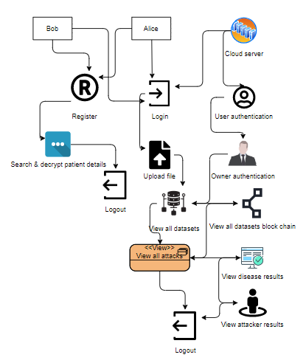
BLOCK DIAGRAM

Slide 26
BLOCK DIAGRAM

Slide 27
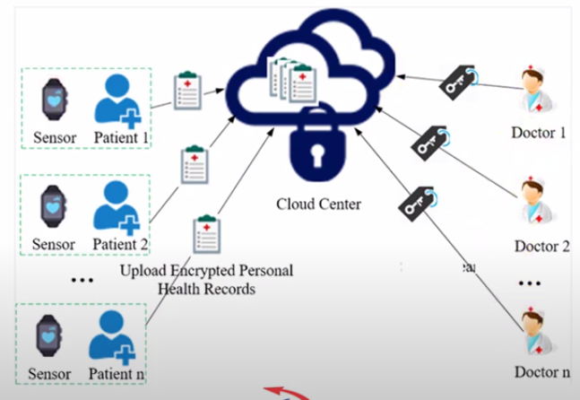
SYSTEM ARCHITECTURE

Slide 28
SYSTEM ARCHITECTURE

Slide 29
DFD LVL 0
AMIN
USER
SYSTEM

Slide 30
DFD LVL 1

Slide 31
ALGORITHMS USED
ALGO:
Symmetric Algo
DES
The Data Encryption Standard (DES) is a symmetric-key algorithm for the encryption of digital data.

Slide 32
Start
Patient
Doctor
Doctor-in-agent
Cloud
METHODOLOGY IS A SET OF PROCESSES USED TO COMPLETE LARGE WORK TASKS.
LOGIN
LOGIN
LOGIN
LOGIN
Upload PHR, View uploaded encrypted PHR, View Decrypted PHR.
View assigned Patient, Search patient, Request for doctor, View shared patient, Decrypt patient details, View the patient details.
View PHR requests, Approve PHR Request, View Patient Details,
View Cloud files, View patient details, View doctor details, View graph.

Slide 33
MODULES SPLIT UP
MODULES:
Patient
Doctor
Cloud Server
Data collection and encryption phase
Data retrieval phase
Conditional authorization

Slide 34
CONCLUSION
We design a new secure and practical proxy searchable re-encryption scheme, allowing medical service providers to achieve remote PHRs monitoring and research safely and efficiently
patients’ healthcare records collected by the devices are encrypted before uploading to the cloud server ensuring privacy and confidentiality of personal healthcare records(PHR)
only authorized doctors or research institutions have access to the PHRs
Alice (doctor-in-charge) is able to delegate medical research and utilization to Bob (doctor-in-agent) or certain research institution through the cloud server, supporting minimizing information exposure to the cloud server.
The cloud server can operate search over encrypted PHRs on behalf of the doctor without learning information about the keyword or the underlying condition. Specifically, we achieved the property of proxy-invisible in the system.

Slide 35
REFERENSES
M. Blaze, G. Bleumer, and M. Strauss, ‘‘Divertible protocols and atomic proxy cryptography,’’ in Advances in Cryptology-EUROCRYPT. Berlin, Germany: Springer, 1998, pp. 127–144.
J. Baek, R. Safavi-Naini, and W. Susilo, ‘‘Public key encryption with keyword search revisited,’’ in Proc. Int. Conf. Comput. Sci. Appl. (ICCSA), 2008, pp. 1249–1259.
LINLIN XUE, “DSAS: A Secure Data Sharing and Authorized Searchable Framework for e-Healthcare System”, IEEE Access (Volume: 10), 2022.

Slide 36
REFERENSES
LINLIN XUE, “DSAS: A Secure Data Sharing and Authorized Searchable Framework for e-Healthcare System”, IEEE Access (Volume: 10), 2022.

Slide 37
THANK YOU

Slide 38
THANK YOU

